Slide 1
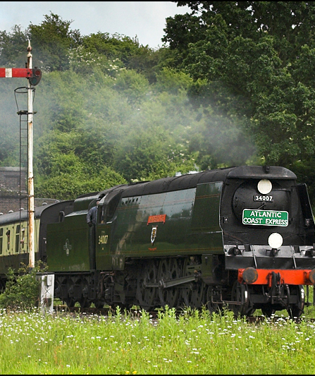
After Launch: Packs, Locomotives and History
How the mod could grow after the first release. All of it comes later.
A real locomotive, for illustration. Photo: Ben Salter, CC BY 2.0.

Slide 2
How to read this guide
Decided.
AGREED
Suggested, not confirmed.
PROPOSED
A test number that may change.
PROVISIONAL
Still an open question.
UNDECIDED
A real-world fact.
BACKGROUND
Every idea carries a tag in the top-right corner.
2

Slide 3
Core comes first
AGREED
Later packs
Later packs
Later packs
Core 1.0: complete
The core game is finished first. Nothing is held back to sell packs.
3

Slide 4
One shared engine
AGREED
Data card
Data card
Core engine
Pack engine
Shared rules
Packs add new engines, not new physics. Everything runs on the same rules.
4

Slide 5
Packs by region
PROPOSED
Region A pack
Region B pack
Region C pack
Engines
Engines
Engines
Buildings
Buildings
Buildings
History
History
History
Pack names: undecided (OQ20)
Price: undecided (OQ26)
Separate regional packs could add fleets, buildings and history.
5

Slide 6
Growing by updates
PROPOSED
Update
Update
No charge per locomotive.
Launch
Early-access pricing: undecided (OQ26)
A pack could start small and grow through updates, free to its owners.
6

Slide 7
Packs work together
AGREED
Pack
Pack
Core game
Pack
Shared rules
Packs need the core game and can be mixed. They share the same rules.
7

Slide 8
Beyond Small, Medium, Large
AGREED
Small
Candidate names only
Shunters
Mixed Traffic
Medium
Fast Freight
Heavy Freight
Large
Names: undecided (OQ20)
With many engines, you browse by job instead of only by size.
8

